Slide 1

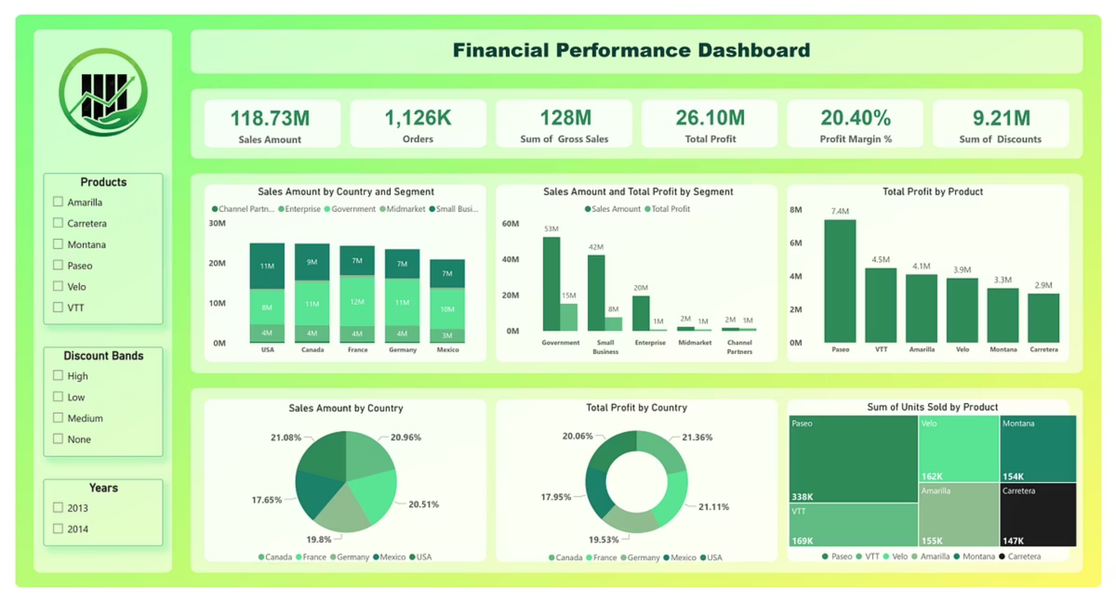

Overview
“This dashboard delivers a clear view of financial performance across sales, profit, units sold, and discounts, segmented by product, country, and business type. It helps identify key trends, compare performance across regions, and uncover profit drivers and inefficiencies. From highlighting the Government segment's dominance to revealing high-volume products like Paseo, the dashboard enables smarter decisions backed by data-driven insights.”

Slide 2
📌KPI Summary
$118.73M
1.126M
$128M
Total Sales Amount
Orders Total
Gross Sales
$26.1M
20.4%
$9.21M
Total Profit
Overall Profit Margin
Total Discounts
“Here are the key performance indicators: Total Sales Amount stands at $118.73 million, Orders total 1.126 million, Gross Sales are $128 million, Total Profit is $26.1 million, The overall Profit Margin is 20.4%, And the total Discounts given amount to $9.21 million. These KPIs offer a quick snapshot of our business performance.”

Slide 3

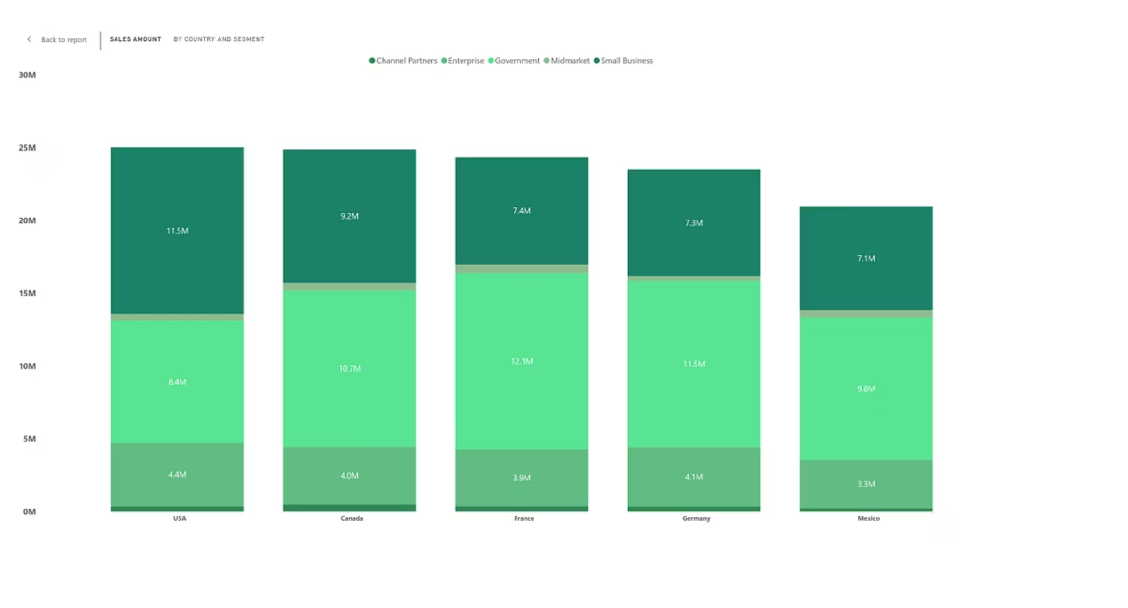
🌍Country-wise Sales Breakdown by Segment (Stacked Column)
“This stacked column chart shows how sales vary by segment in each country. The Government segment dominates in every market, peaking in France with $12.13M. Small Business follows closely, with the USA leading at $11.46M. Meanwhile, Enterprise and Channel Partners contribute less than $1M each, indicating untapped potential in these markets.”

Slide 4

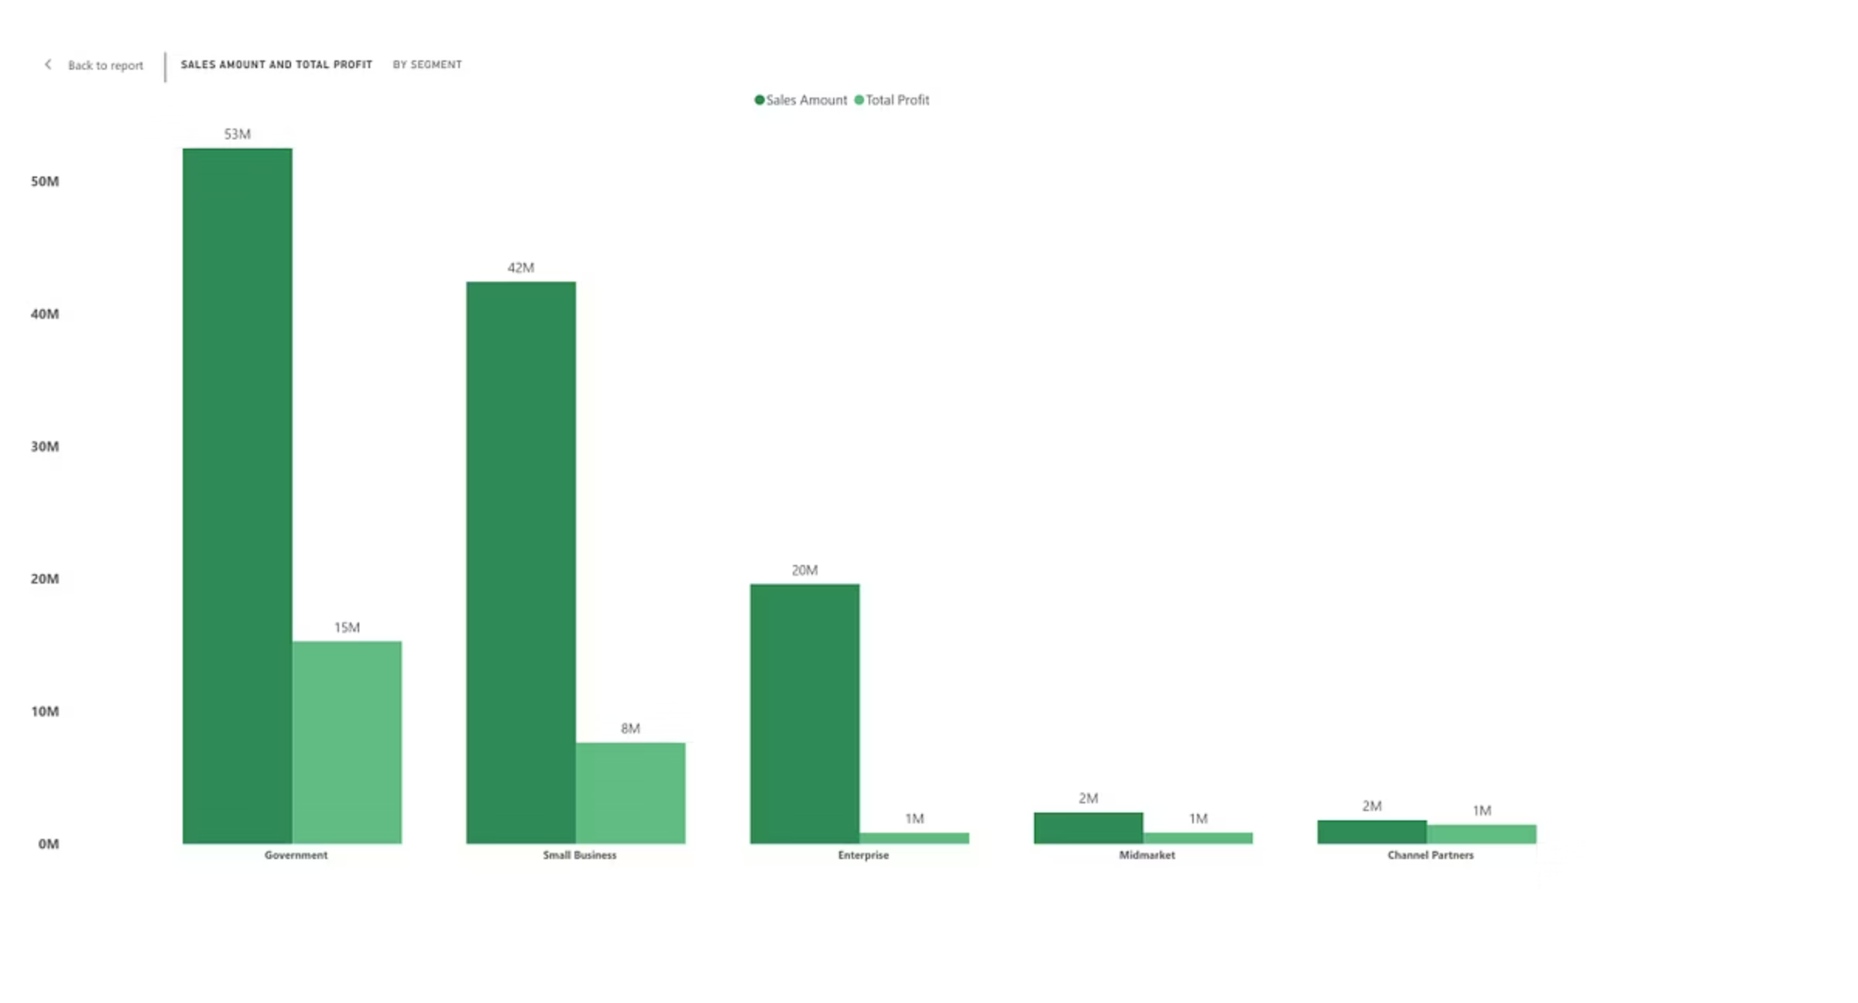
📊 Sales & Profit by Segment (Clustered Column)
“Here, we compare sales and profit across segments. Despite generating $19.6M in sales, the Enterprise segment records a loss of ~$614.6K, pointing to a serious margin issue. The Government segment delivers the highest profit at $11.39M on $52.5M sales, indicating both volume and profitability strength. Interestingly, Channel Partners, though smaller in sales, deliver a 73% profit-to-sales ratio, showing efficiency in cost and discount handling.”

Slide 5

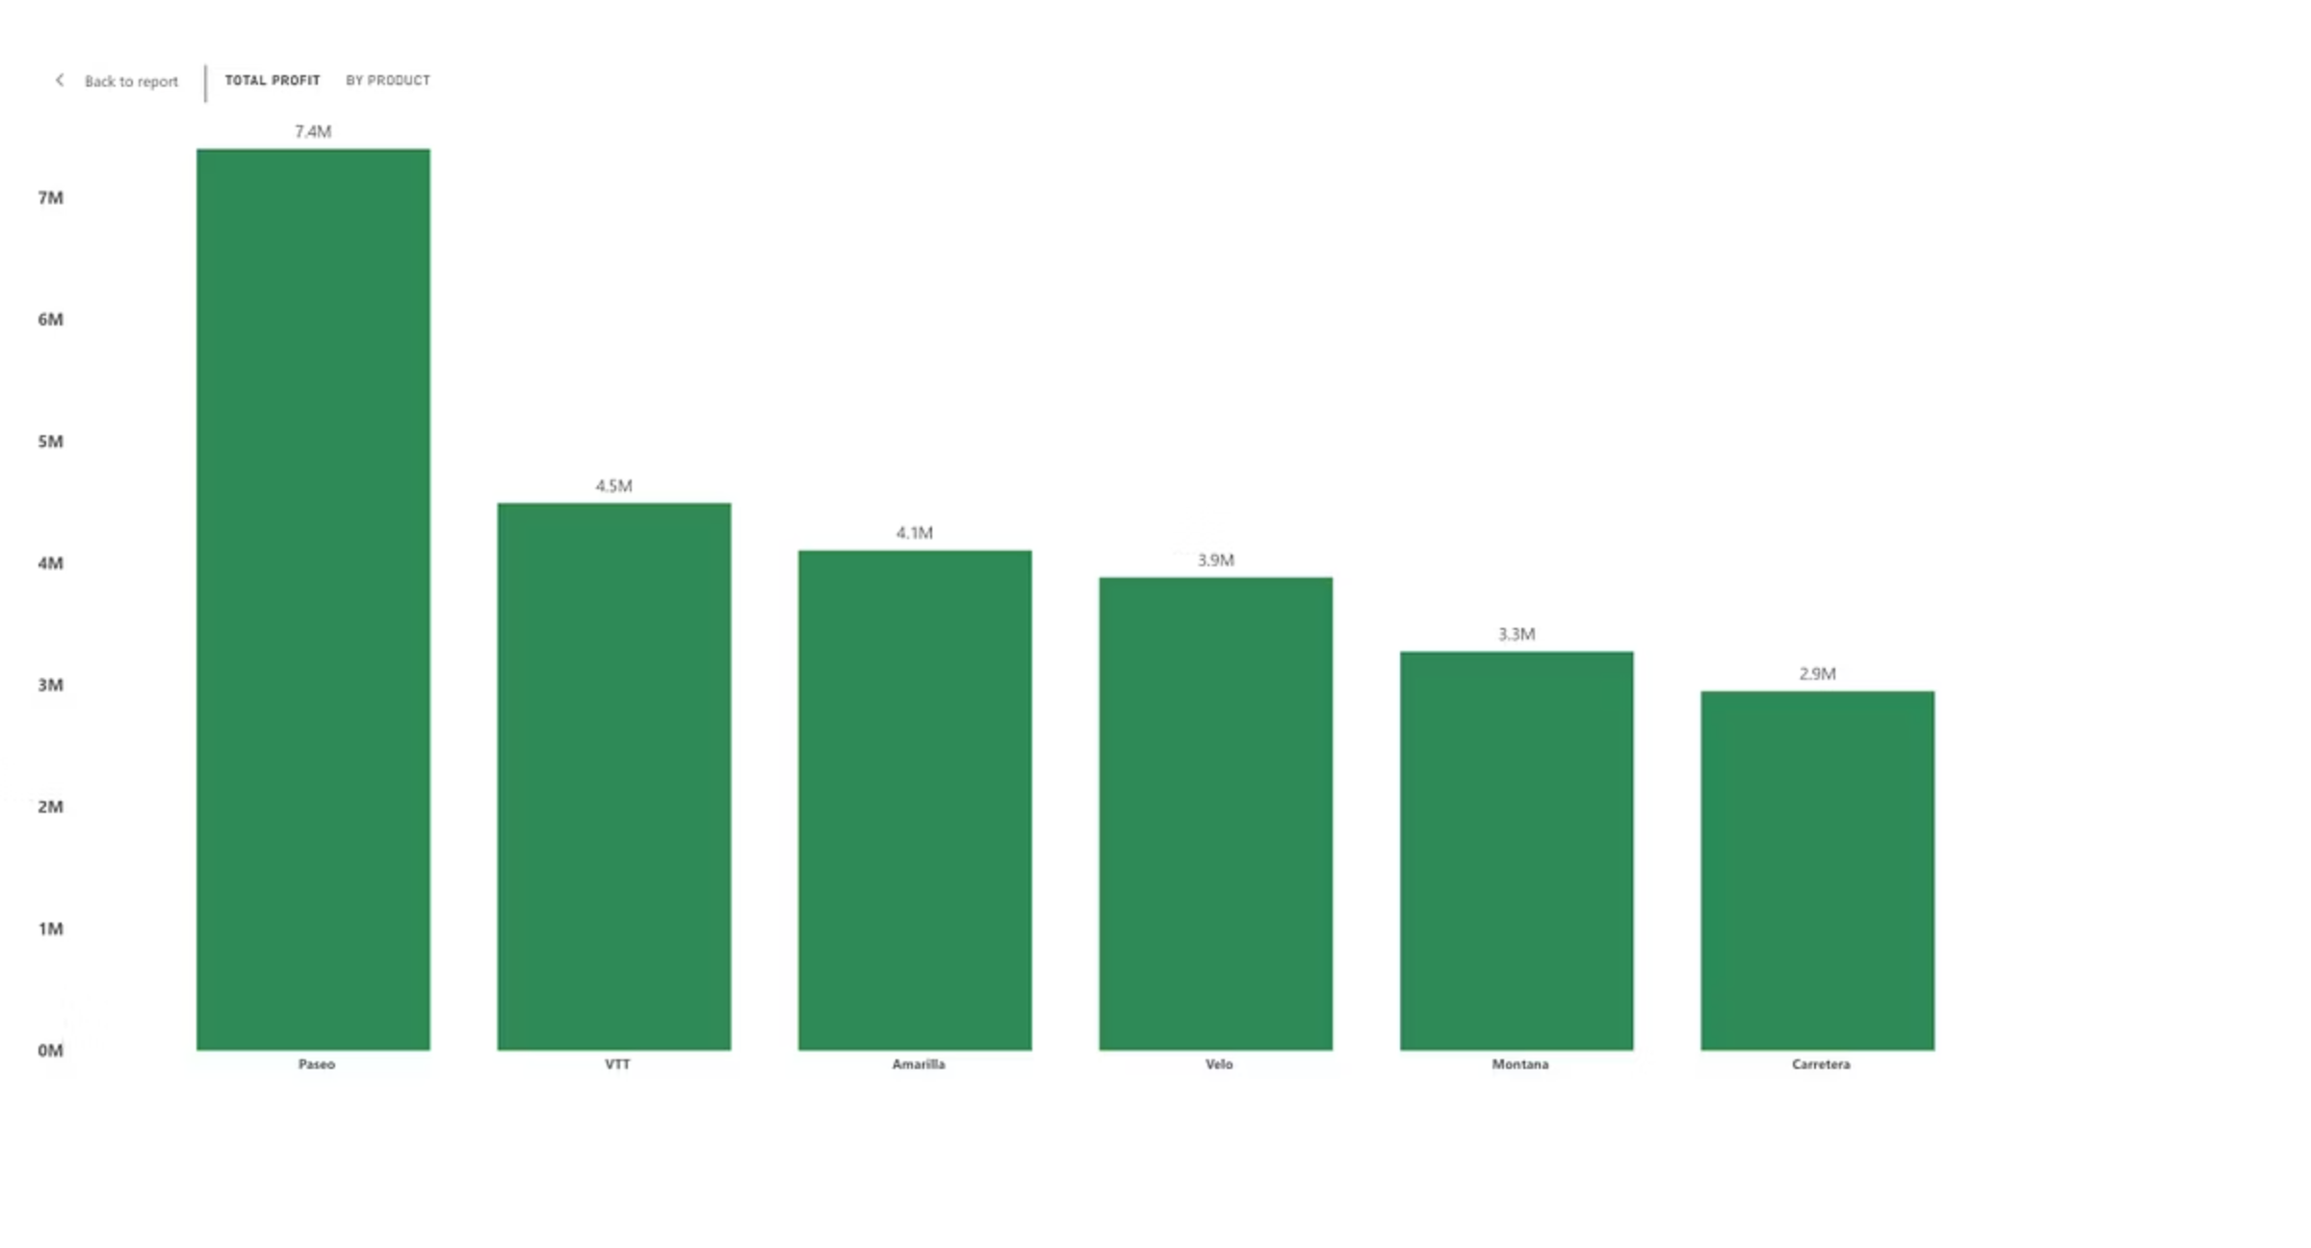
📦 Profit by Product (Stacked Column)
“This visualization highlights product-level profitability. Paseo leads with $7.4M profit, followed by VTT at $4.5M, and Amarilla at $4.1M. These top-performing products are vital to overall profitability and warrant focused promotion and inventory prioritization.”

Slide 6
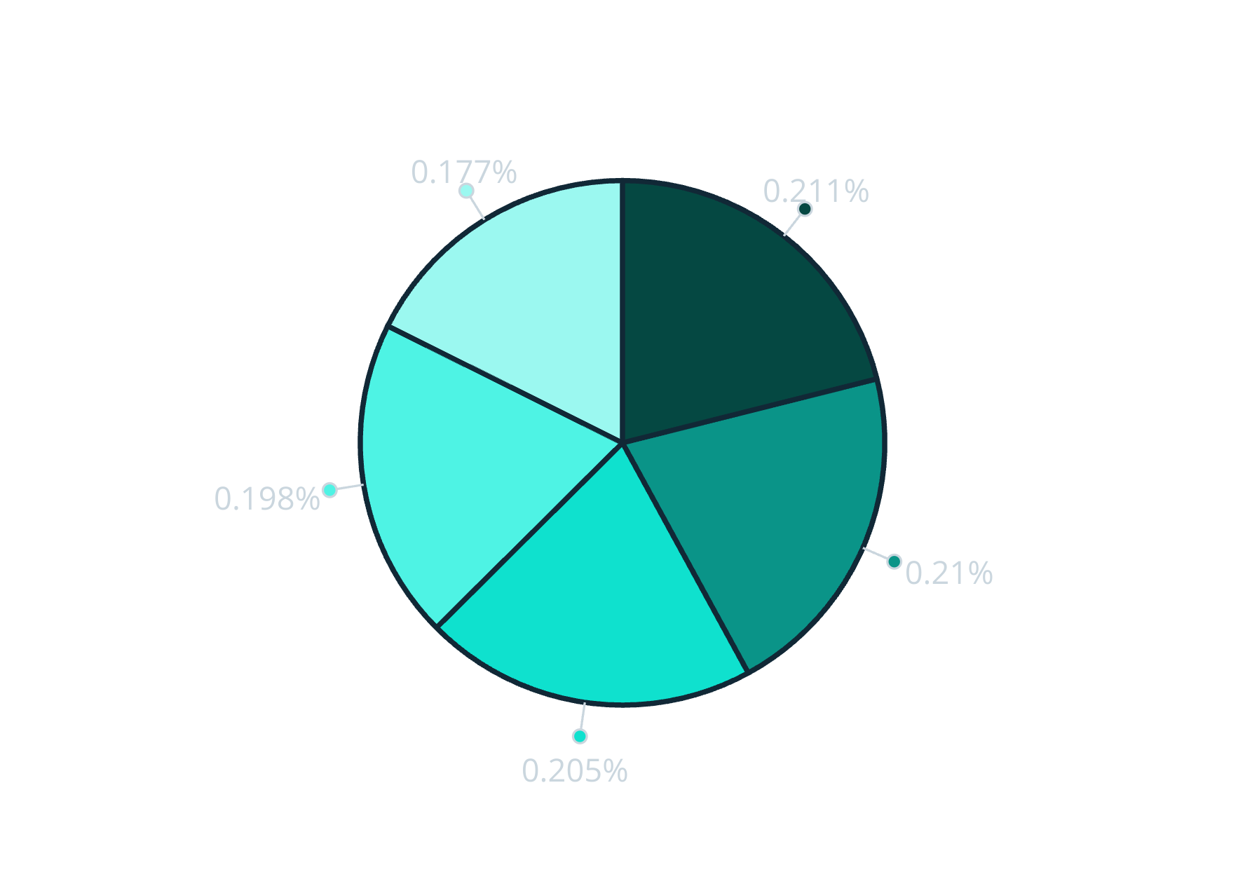
🗺️ Sales by Country (Pie Chart)
USA
Canada
France
Germany
Mexico
“This pie chart displays the distribution of total sales across countries. USA leads with 21.08%, closely followed by Canada (20.96%), France (20.51%), Germany (19.8%), and Mexico (17.65%). The sales share is well-balanced, suggesting consistent market penetration across major geographies.”

Slide 7
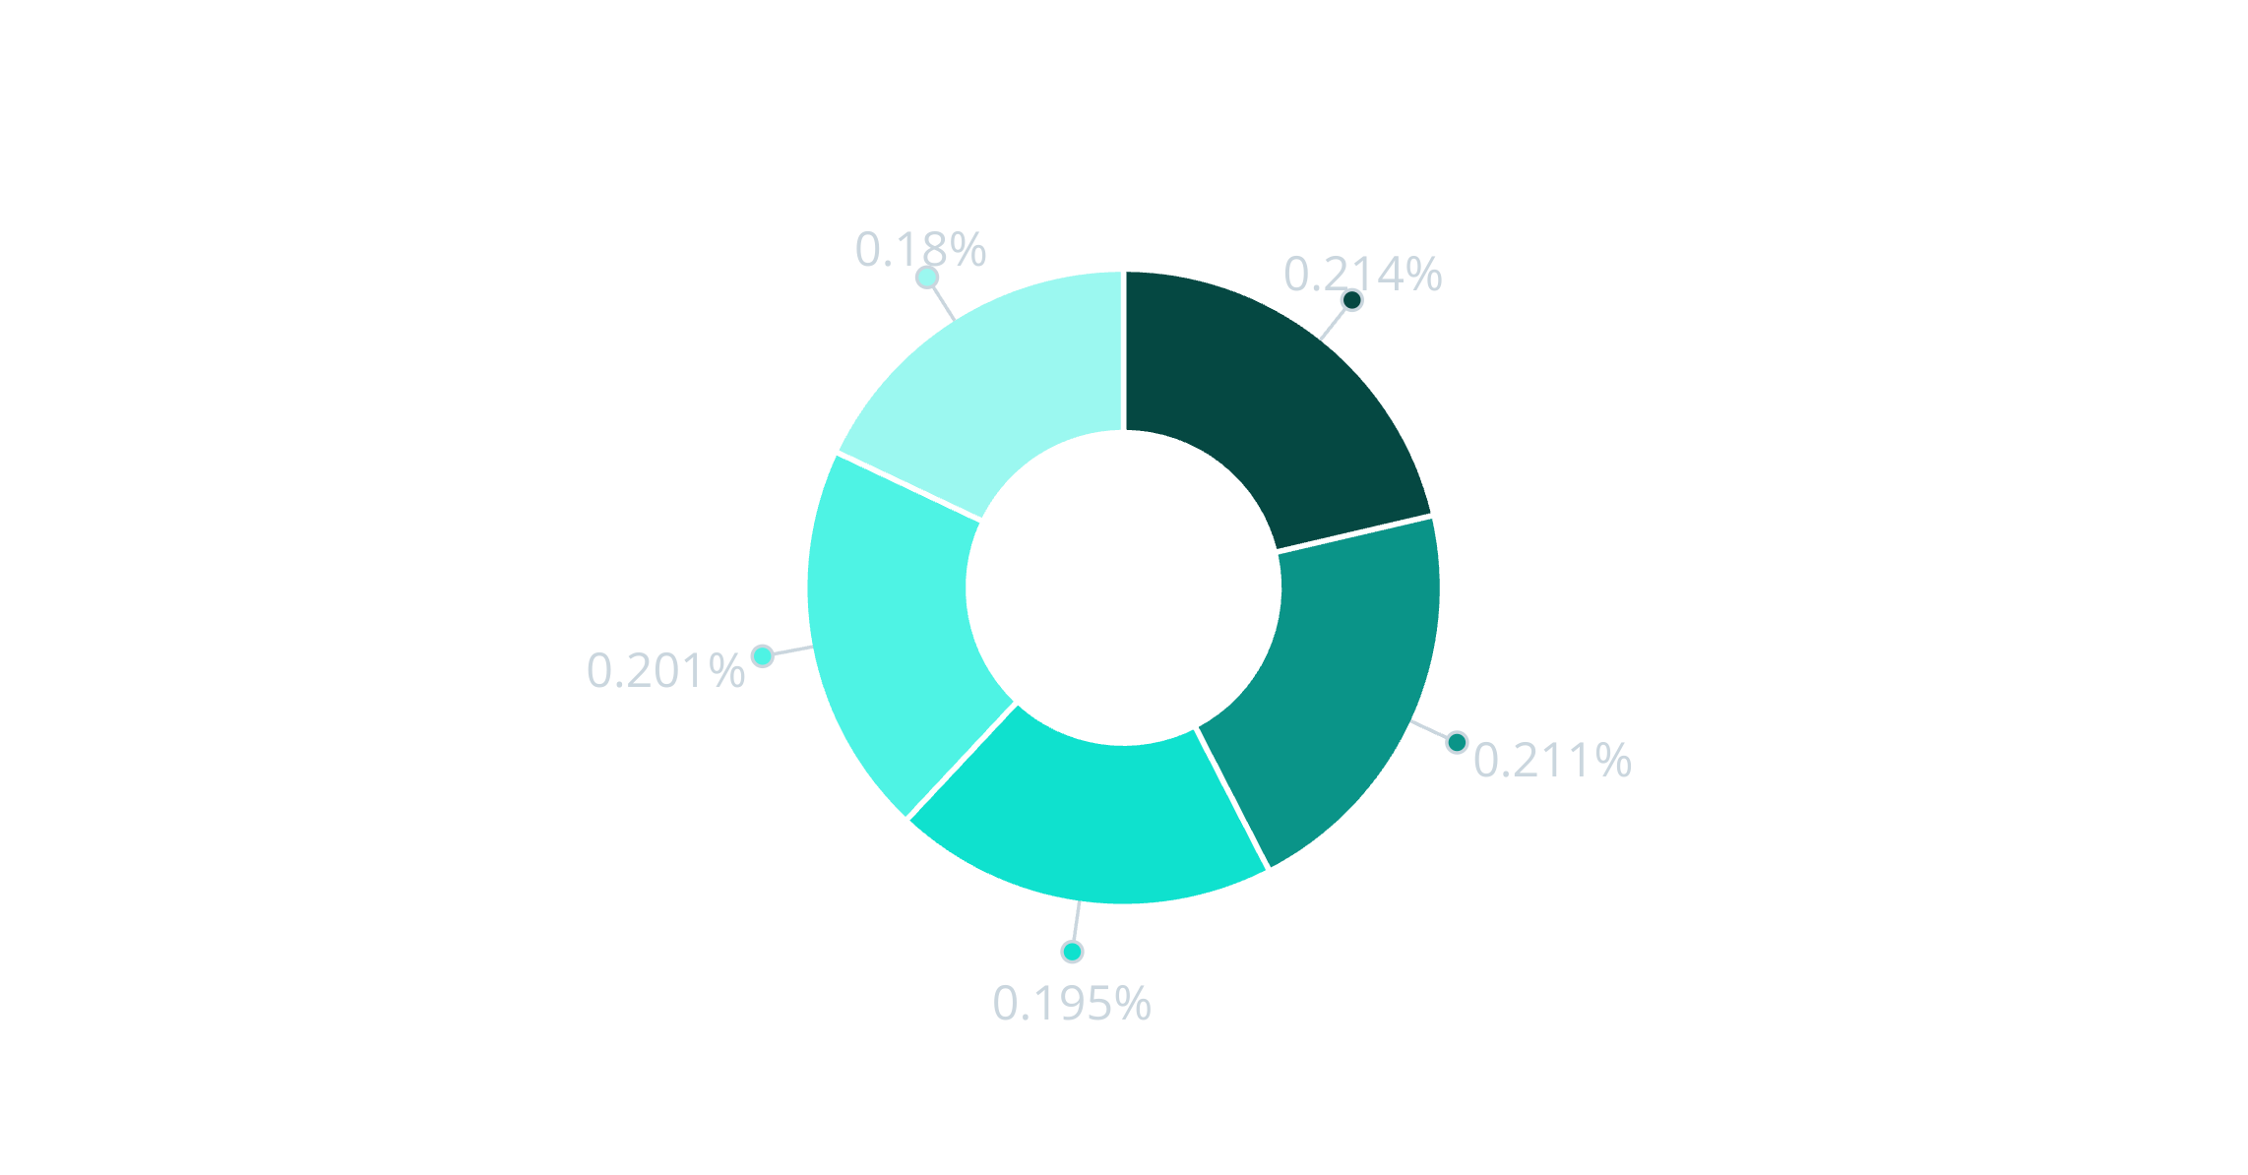
💰Total Profit by Country (Donut Chart)
Canada
France
Germany
USA
Mexico
“When we look at profit distribution, the numbers mirror sales: Canada slightly edges others at 21.36%, followed by France (21.11%), Germany (19.53%), USA (20.06%), and Mexico (17.95%). This indicates that profit scales closely with sales volume across regions, with no major outliers.”

Slide 8

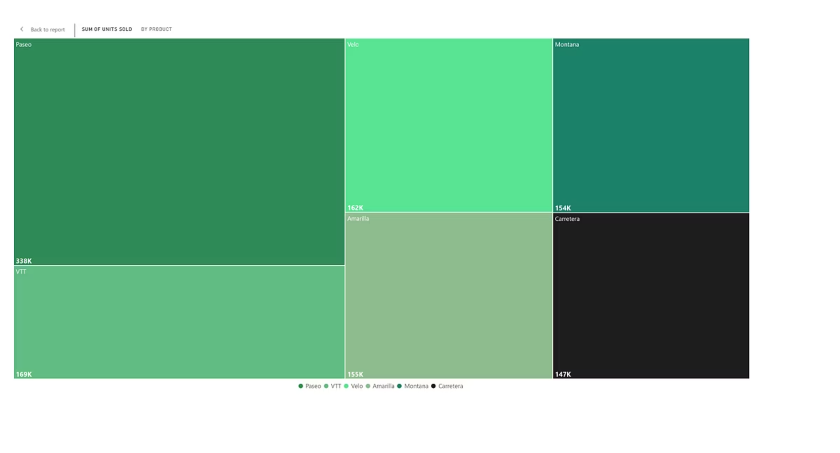
📦 Units Sold by Product (Treemap)
This treemap represents the total units sold by product. Paseo is the top mover with 338K units, followed by VTT (169K), Velo (162K), and Amarilla (155K). This suggests Paseo has both high sales volume and profitability, making it a strategic product line.”

Slide 9





📈 Key Takeaways & Strategic Insights
Government Segment
is our most profitable and high-volume segment.
Enterprise
is underperforming, requiring margin restructuring.
USA and France
show the strongest market expansion and year-over-year growth.
Products like Paseo and VTT
are core revenue drivers.
Segments like Channel Partners
though smaller in sales, offer exceptional profit efficiency. These insights can inform sales strategy, pricing adjustments, and expansion priorities.”

Slide 10
🙏Thank You
“Thank you for your time. I’d be happy to take any questions or walk through specific parts of the dashboard.”

